Slide 1
Data clustering: 50 years beyond K-means
Ning Yu, Hao Wu, Zhengkun Li
Jain A K. Data clustering: 50 years beyond K-means[J]. Pattern recognition letters, 2010, 31(8): 651-666.

Slide 2
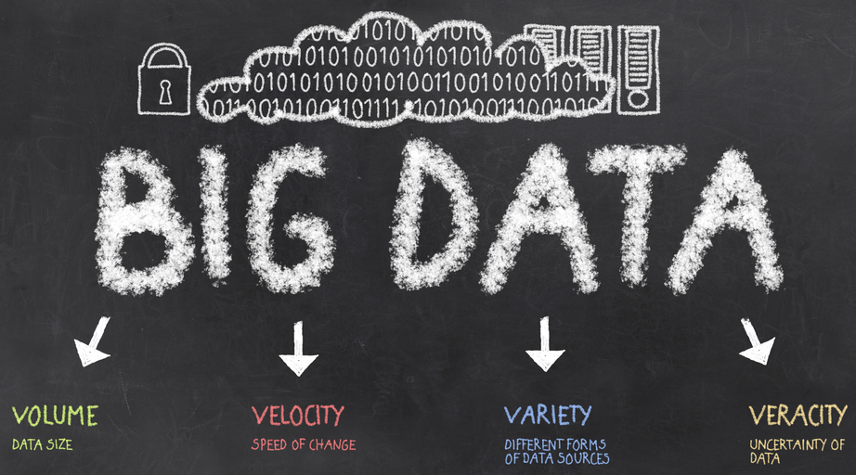

Age of Big Data
Internet search, digital imaging, video surveillance, RFID tags, transponders, emails, blogs, transaction data, web pages
→ high volume, high dimension
→ variety, uncertainty
→ methodology to automatically
understand, process, and summarize
data

Slide 3
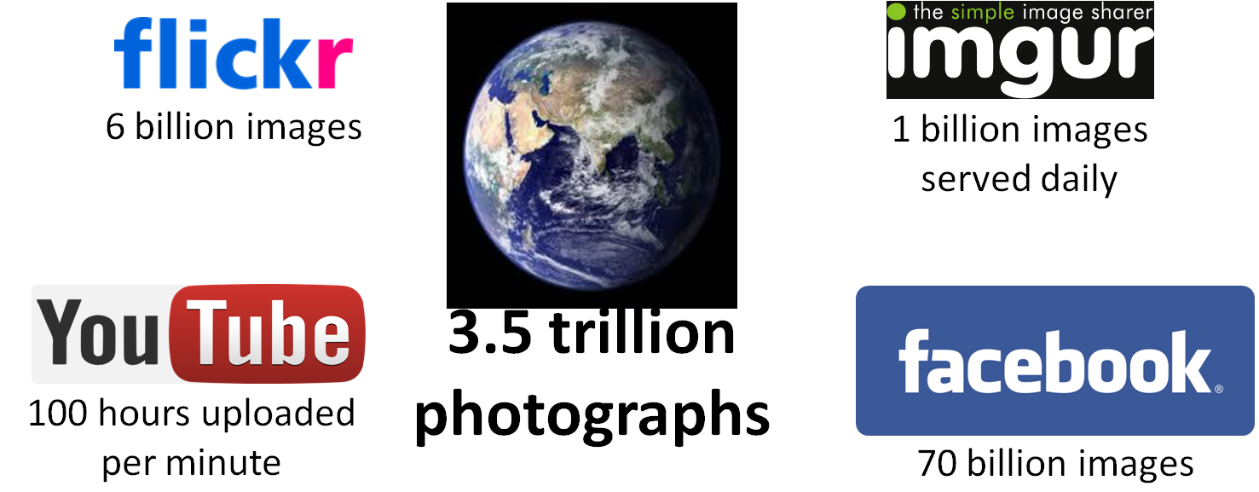
Big Visual Data Examples

Slide 4
Data Analysis —— A Super-Concept of Clustering
Two types of techniques:
exploratory: no pre-specified model, but propose to understand the general characteristics or structure of the high-dimensional data
inferential: confirm a model given the available data
Clustering tasks inherit from both:
learn/train from old data, and predict/validate for new data
Compared to classification:
clustering tackles data without label ground truth → unsupervised learning → more challenging
clustering maximizes the usage of available information
clustering may include contraints: must-link constraint and cannot-link constraint

Slide 5
Clustering
Goal of clustering:
discover the natural grouping(s) of a set of patterns, points, or objects
Our objective:
develop an automatic algorithm to do that above

Slide 6
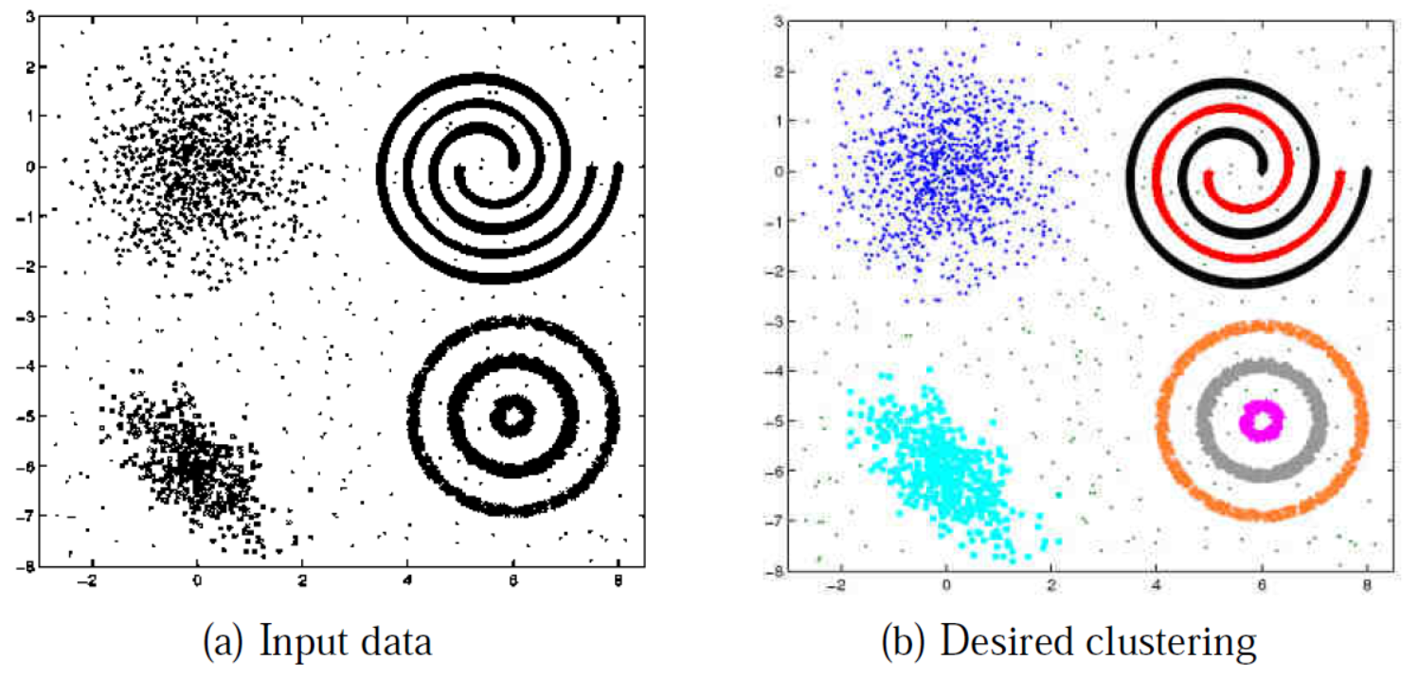
Challenges
Clusters can differ in terms of shape, size, and density.
A cluster is defined as a set of points in the feature space that is compact and isolated.
The noise in the data makes the detection of clusters more difficult.
Unknown number of clusters makes the task even more challenging.
Notes:
Diversity of clusters. The seven clusters in (a) (denoted by seven different colors in 1(b)) differ in shape, size, and density. Although these clusters are apparent to a data analyst, none of the available clustering algorithms can detect all these clusters.

Slide 7

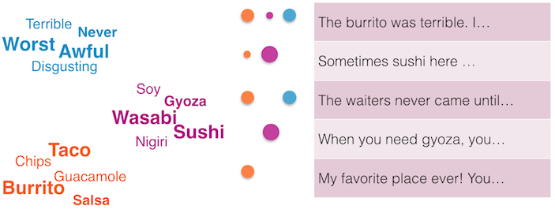
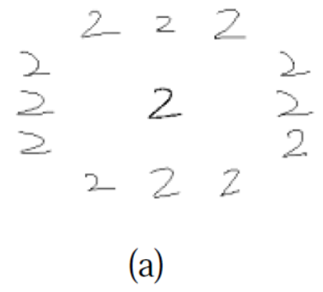
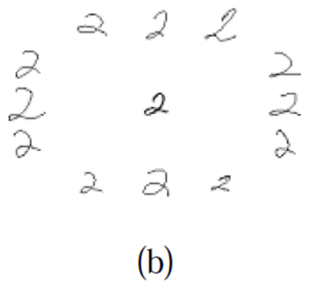
Why Clustering?
Applications:
image segmentation
document topic modeling
sub-mode discovery in hand-written character recognition

Slide 8
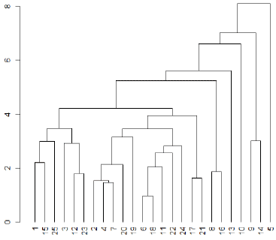
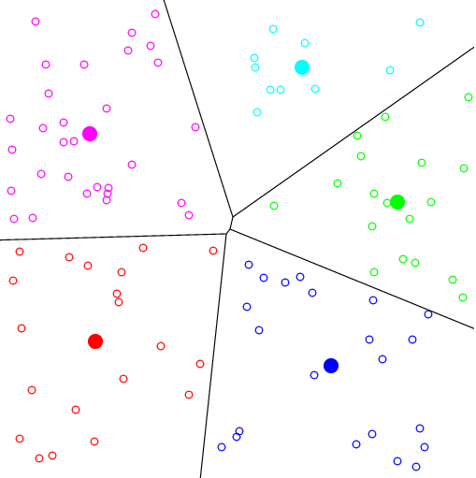

Clustering Algorithms
Hierarchical clustering: recursively find nested clusters based on similarity matrix (single/complete link measurement)
agglomerative mode → bottom up → from individual and merge
divisive mode → top down → from a whole and divide-and-conquer
Partitional clustering: find all the clusters simultaneously as a partition of the data based on either similary matrix or feature matrix
→ K-means
→ ease of implementation, simplicity, efficiency, and empirical success

Slide 9
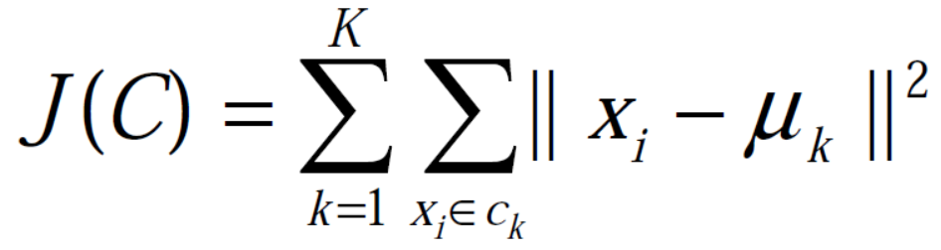
K-means
X = {x_{i}}, i = 1, …., n is the set of n d-dimensional feature points to be clusttered
C = {c_{k}}, k = 1, …., K is the set of clusters; 𝝻_{k} is the mean of cluster c_{k}
The goal of K-means is to minimize the sum of the squared error over all K clusters:

Slide 10
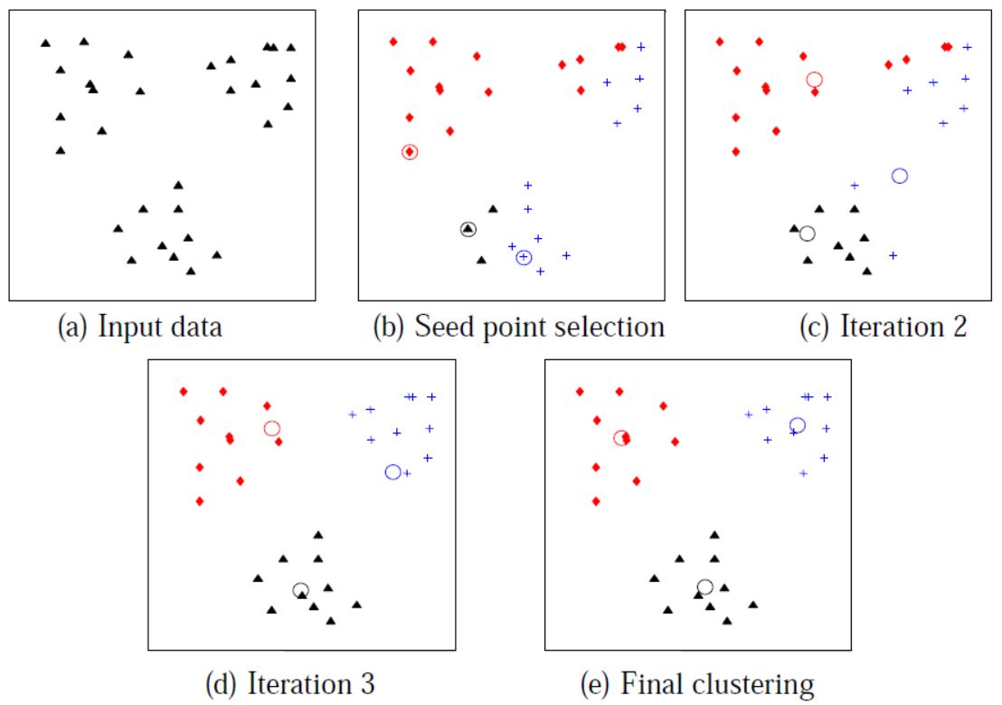
K-means
Select an initial partition with K clusters; repeat steps 2 and 3 until cluster membership stabilizes.
Generate a new partition by assigning each pattern to its closest cluster center.
Compute new cluster centers.

Slide 11
K-means
Number of clusters K:
No perfect mathematical criterion
Choose a K with the most meaningful partition to the domain experta
Initialization:
Local optimum result → different initialization can lead to different results
For a given K, choose an initialization with the smallest squared error
Distance metric:
Euclidean metric → ball-shape clusters
Mahalanobis distance → ellipsoidal-shape clusters (and higer computation burden)

Slide 12
Extensions of K-means
Additional heuristics involving the minimum cluster size and merging and splitting clusters: ISODATA and FORGY
Cluster soft-assignments: Fuzzy C-means
Hierarchical divisive version: bisecting K-means
Efficiently identify the closest cluster center: by kd-tree
Fast scable and single-pass version: X-means
Median instead of mean: K-medoid
Kernel similarity: Kernel K-means

Slide 13
Approaches beyond K-means
Density-based methods:
Jarvis-Patrick algorithm
DBSCAN
Latent Dirichlet Allocation (LDA) and Pachinko Allocation (PA) model
Subspace clustering:
CLIQUE
Spectral clustering:
Minimal Cut
Ratio Cut
Normalized Cut
Information-Theory-based methods:
Minimum Entropy
Information Bottleneck
Notes:
Different definitions of connectedness
Some data points can only be separated in the projection of a subspace
to partition the nodes into two subsets A and B, such that the sum of the weights assigned to the edges connecting between nodes in A and B is minimized.
find the best cluster assignments such that the conditiona entropy is minimized, that is, the overlap between unconditional density and conditional density given a cluster estimation is minimized

Slide 14
User’s Dilemma
How do we choose the number of clusters K ?
What’s the best clustering algorithm for my specific dataset ?
Does my clustering result really make sense ?
………..

Slide 15
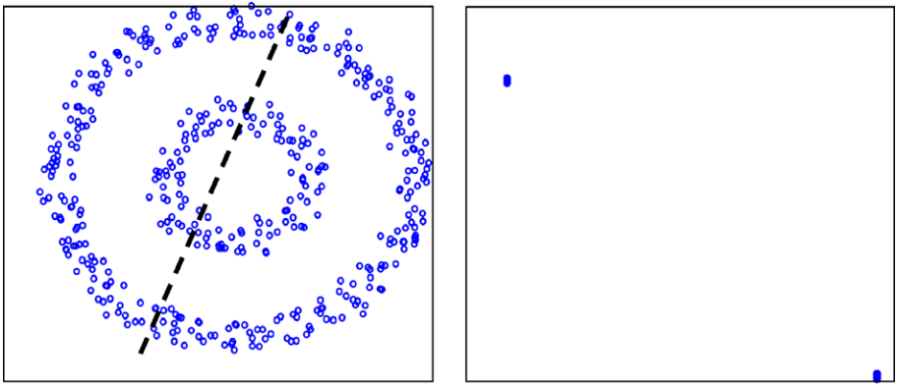
Data representation
Good data representation helps the clusters to be compact and isolated.
Different data representation would result in different clustering performance.

Slide 16
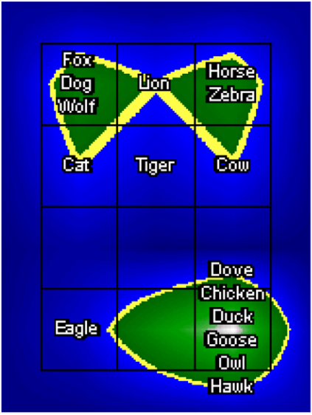
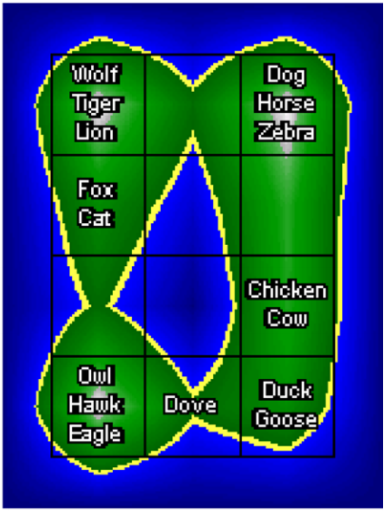
Purpose of grouping
The dataset can have different partitionings, so user’s purpose of grouping decides which one is the desired one.
Each animal is represented using
13 boolean features related to
apprearance and activity.
apprearance - mammals vs birds
activity - predators vs nonpredators

Slide 17
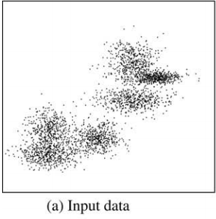
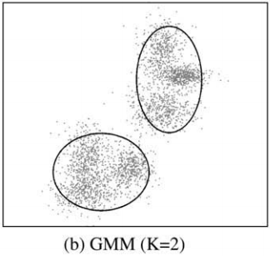
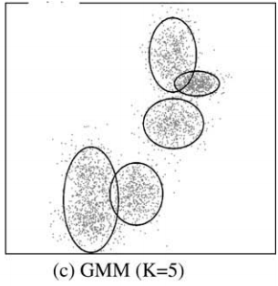
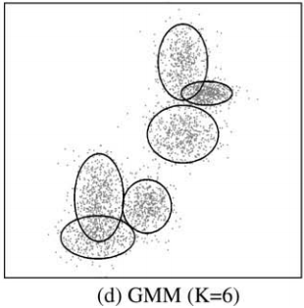
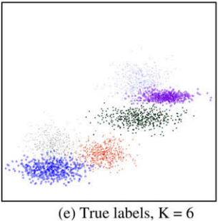
Number of clusters - K

Slide 18
Number of clusters - K
We choose the best value of K based on predefined criterion.
minimum message length : the approach starts with a large number of clusters, and gradually merges the clusters if this leads to a decrease in the MML criterion.
gap statistics : it is assumed the optimal number of clusters is most resilient to the random pertunbations.

Slide 19
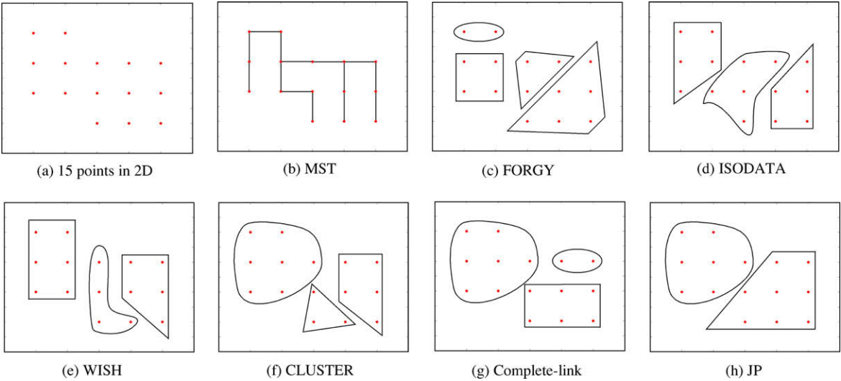
Comparing clustering algorithms
Can we identify algorithms that generate similar grouping irrespective of data ?
i.e. cluster the clustering algorithms

Slide 20
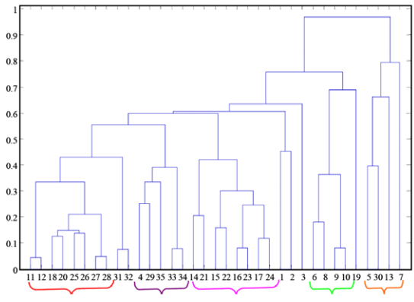
Comparing clustering algorithms
Notes:
The researchers clustered 35 clustering algorithms into 5 groups based on their partitions on 12 different datasets. The similarity between algorithms are measured as the average similarity between the partitions on the 12 datasets.

Slide 21
Comparing clustering algorithms
there is no best clustering algorithm. When there is a good match between the model and data, good partition is obtained.
if the structure of data is not known, one needs to try different methods to determine an approriate one.

Slide 22
Trends in data clustering
Information explosion: diverse set of data
- Unstructured: images, text, audio, video, etc.
- Structured: semantic relationship
Challenge: Process huge amount of heterogeneous data
Notes:
Information explosion in recent years has created large amount of data as well as a diverse set of data.
There are some unstructured data like …
also we have structured data which has a semantic relationship among its attributes.
And the challenge brought by those information is how to process huge amount of heterogeneous data
Now let’s see some of the recent trends in data clustering.

Slide 23
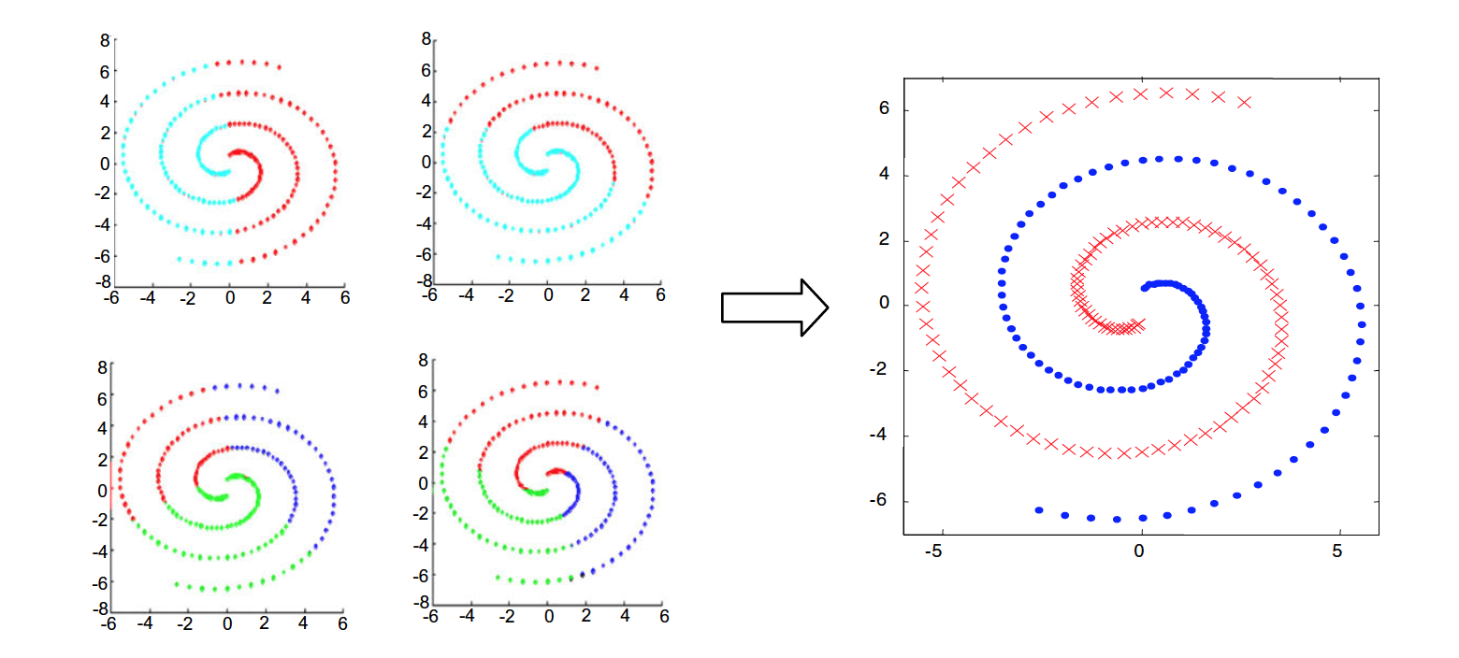
Clustering ensembles
Basic idea: take multiple looks at the same data can generate multiple partitions of the same data and combine them
Notes:
The basic idea is to generate multiple partitions of the same data and combine them
This picture shows an ensembles example of K-Means clustering on two spirals
as we can see on the left side there are four partitions using different K and initial points, and on the right side is the ensemble which clusters the data points by the two spirals.

Slide 24
Clustering ensembles
Different methods to get clustering ensembles
-Applying different algorithms
-Same algorithm with different parameters
-Combining of both
Combining step: learning the similarity measure among the data points
Notes:
The evidence accumulation step, can be viewed as learning the simiarity measure among the data points.

Slide 25
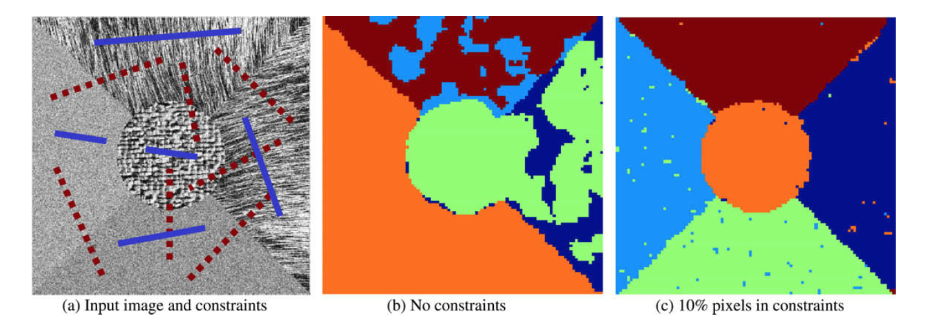
Semi-supervised clustering
Utilize side/external information to find a good cluster
-Pair-wise constraint
Notes:
Next one is called semi-supervised clustering
semi supervised clustering utilize side information to find a good cluster.
those side info are usually pair-wise constraints.
Look this picture below. The input image here has some constraints and the middle pic shows the clustering without using theses constraints, and the third pic shows the clustering with those constraints, which apprently gives a better result.
This chart shows an application called BoostCluster which applys pairwise constraints on three cluster algorithms, and the performance is improved for all three algs.

Slide 26
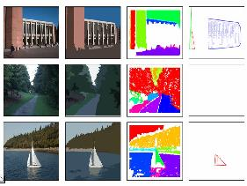

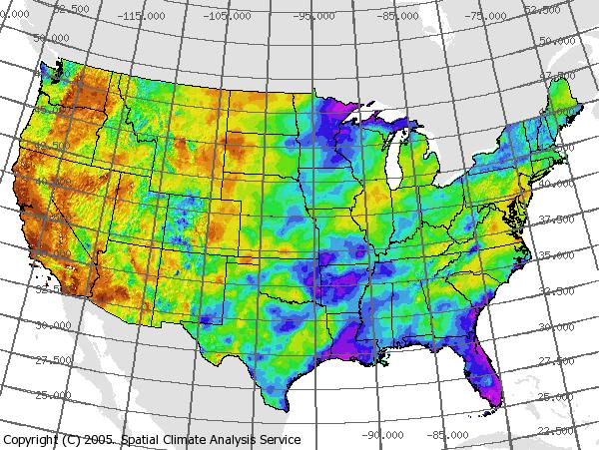
Large-scale clustering
Notes:
Another trend is large scale clustering.
Some clustering jobs deal with a huge amount of data.
for example,

Slide 27
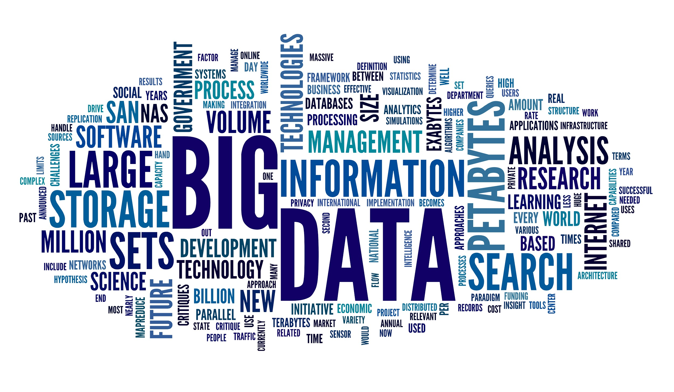
Large-scale clustering
Studies on large scale clustering can be classified into several categories
-Efficient Nearest Neighbor Search
-Data summarization
-Distributed computing
-Incremental clustering
-Sampling based methods
Notes:
Essentially what we are trying to do here is to utilize the resources available and improve the efficiency of our algorithms to deal with the growing data

Slide 28
Heterogeneous data
Objects may not be represented naturally using a fixed length feature vector
Types of heterogeneous data
-Rank data
-Dynamic data
-Graph data
-Relational data
Notes:
For example a document may contain components like title, authors, and references, and apparently we can not simply transform them all into a vector model or some information would be lost in the process.

Slide 29
Multi-way clustering
Co-clustering
-Cluster both features and instances of data
Extended to multi-way clustering
-Cluster a set of objects by simultaneously clustering their heterogeneous components
Notes:
For heterogeneous data a vector space model may not be sufficient to present it naturally.
And that’s why we have multi-way clustering.

Slide 30
Summary
Cluster has been applied in many scientific fields
It’s an exploratory tool, only suggest hypotheses
No single algorithm has been shown to dominate other algorithms across all application domains, more even so with more applications emerging
Notes:
A common approach in data processing

Slide 31
Summary
Still there are problems and research directions
-A suite of benchmark data for testing and evaluating clustering algorithms
-Tighter integration between algorithms and application needs
-Computational issue for large-scale data
-Stability/Consistency
-Choose clustering principles according to their satisfiability of the stated axioms
-Semi-supervised clustering with constraints on data representation and objective function

Slide 32
Q & A

